Slide 1
Business Search engine
Group Members:
-Syed Fazal Ul Hasan Mohani (ERP 23024)
-Ali Asghar Hussain (ERP 24525)
-Tariq Iqbal (ERP 19091)

Slide 2
Table of contents
Introduction
Data Structure/Search Algorithm
Dataset & Project Showcase
References

Slide 3
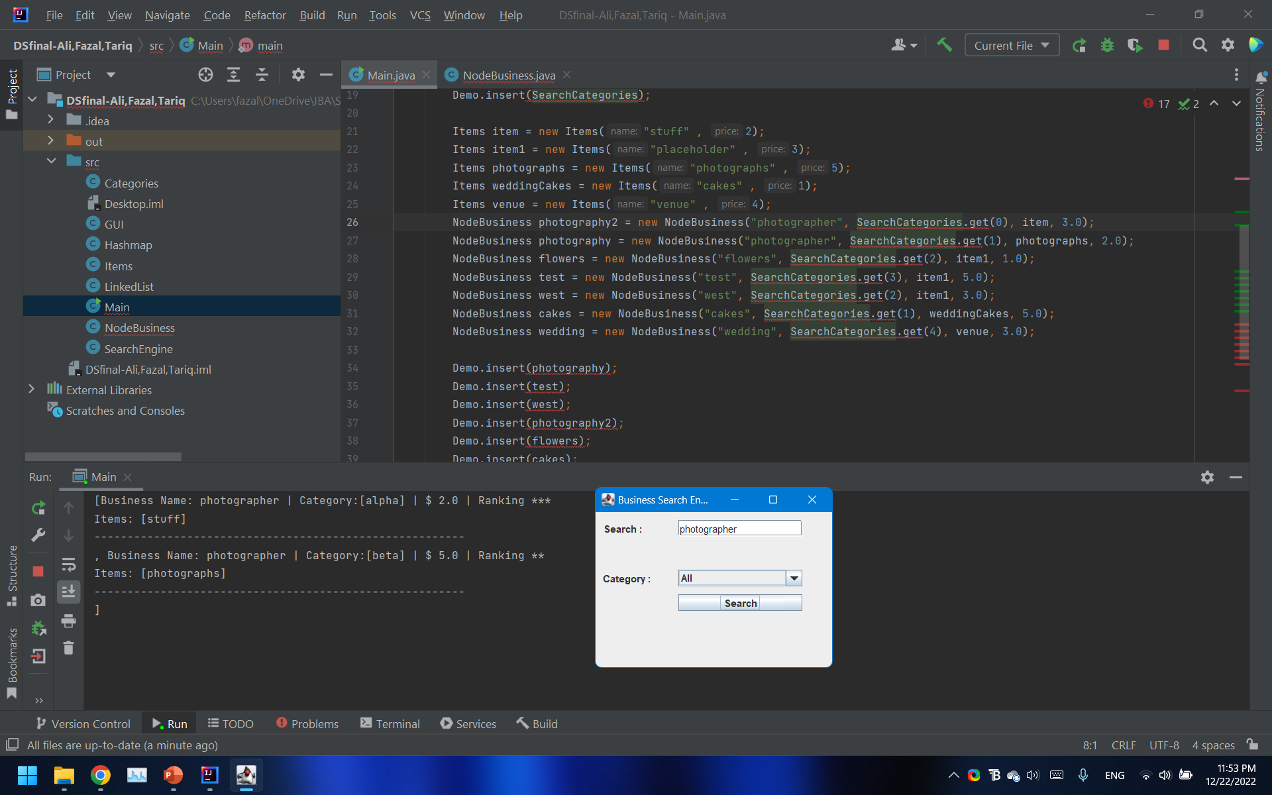
INTRODUCTION
Our Project is a Search Engine that can return results based on text query while specifying a ‘category’. It can also perform ‘keyword search’ and simple query search.
It is similar in concept to a filtered search, such as the one used in Foodpanda.pk where a customer may simply search the name of the restaurant, or they may search the name of the restaurant while specifying a ‘cuisine’.

Slide 4
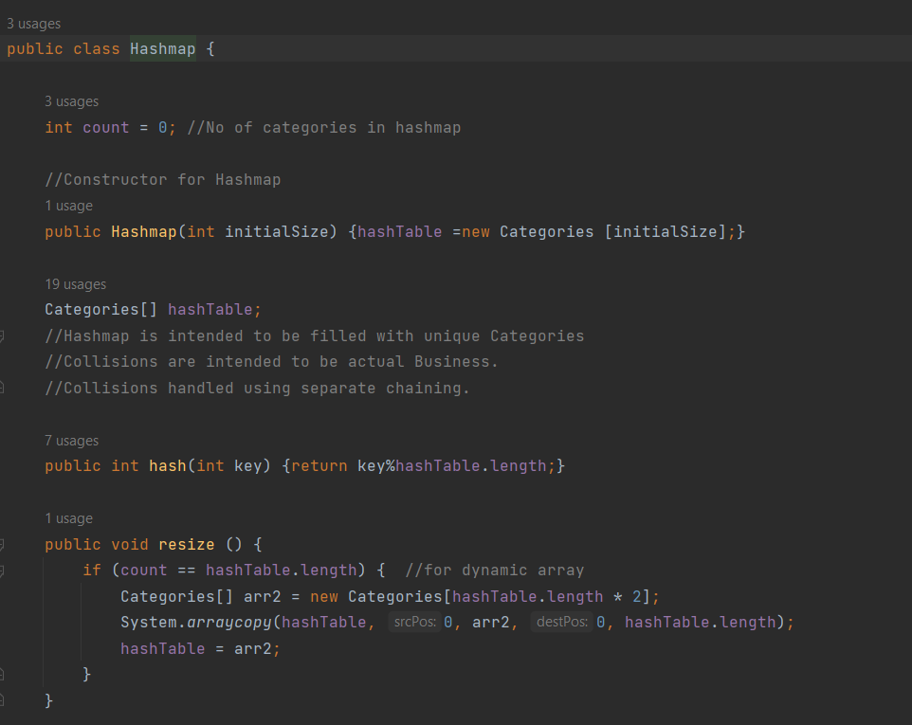
Data structure
We have used a hashmap to store the categories of data.
The hashmap allows for efficient access to categories in O(1) complexity using hashing function.
The Category itself stores the list of Businesses which give services according to the Category (such as Photographer/Restaurant etc)
We have used the Singly Linked List Data Structure for storing the details of Businesses.
Businesses are stored against their Category.

Slide 5
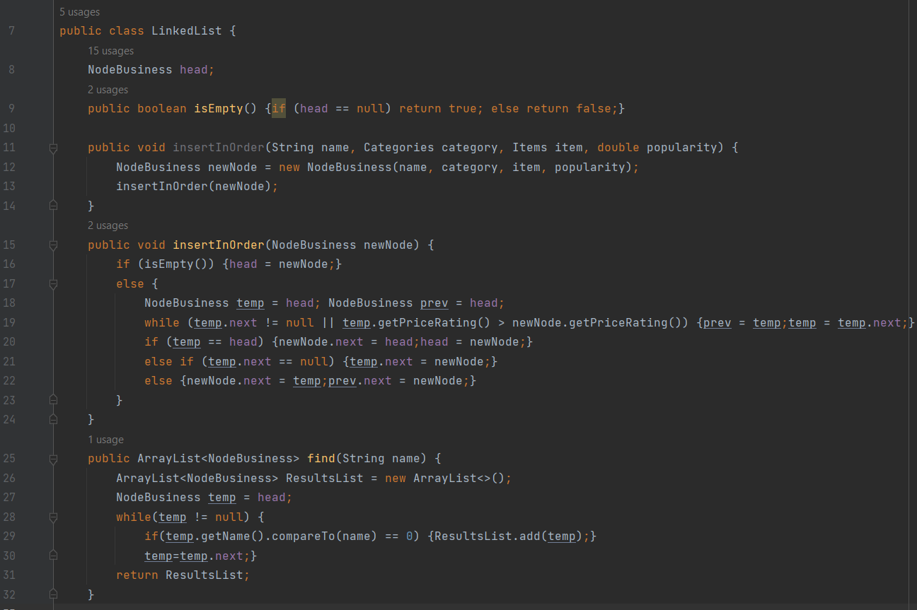
Data structure
The Singly Linked List allows us to perform efficient insertion and deletion of data in O(1) complexity using links between nodes.
The main use of the list structure is Sorted Data at Insertion time into the hashmap, which has O(n) complexity using linkedlists, more efficient compared to O(nlogn) and O(n2).

Slide 6
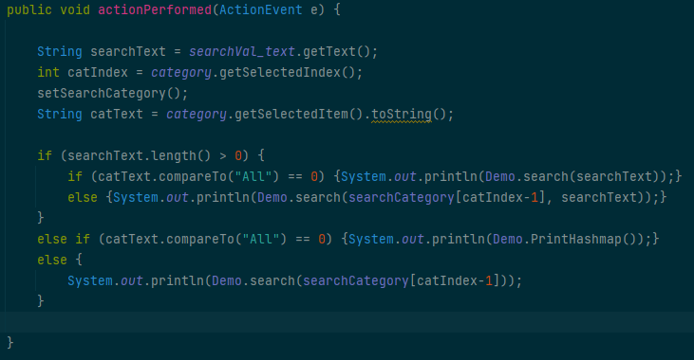
Search Algorithm
The Search Algorithm initially hashes the selected category, then searches through the list of businesses.
Category Search takes O(1) through implementation of Hashmap, whereas the List Search takes O(n).
The creation of categories occurs at Business creation time, that is: if Category of Business does not exist, then create new Category through hashing function; else add Business to existing Category (indicating a collision in the HashMap).

Slide 7
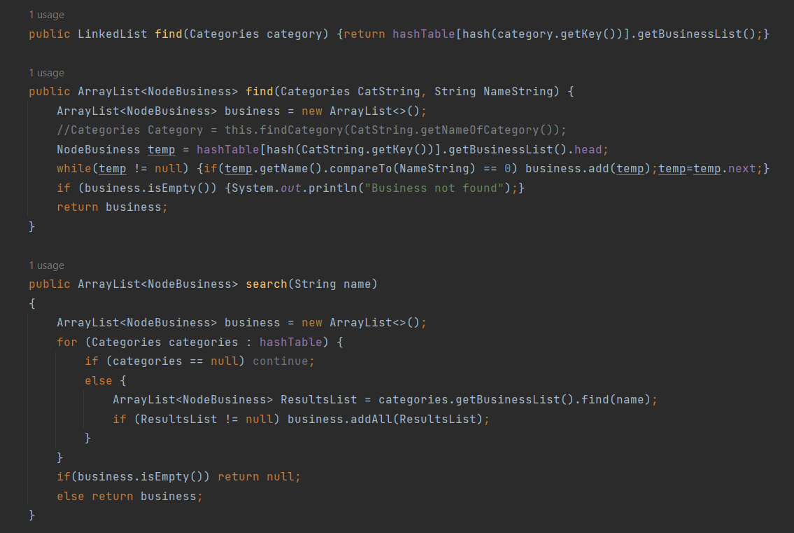
Search RESULTS
We are directly printing the results of our search onto Console.
If a business exists where it satisfies the name and specified category, then it will show up in the search results.
If only category is selected, but no query is given (empty query search), then the businesses of that category are shown.
If a search query is given, and ALL Categories are selected, then it will return the Business which satisfies that search query only.

Slide 8
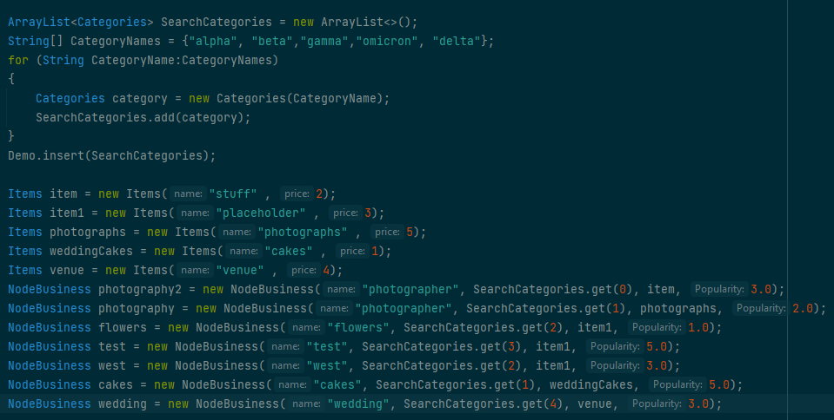
TEST DATASET

Slide 9
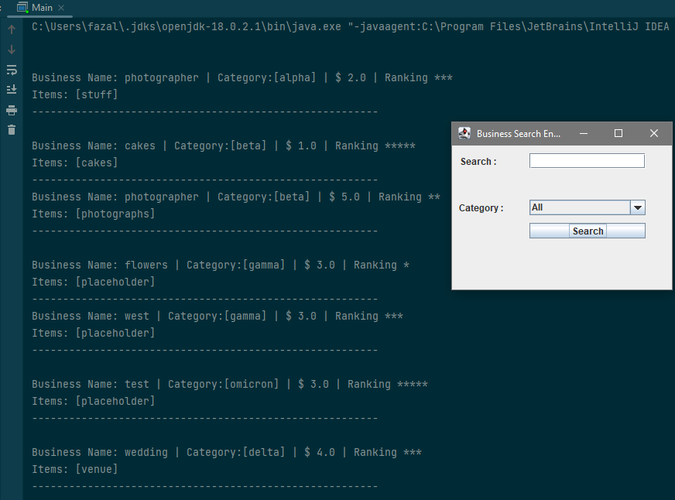
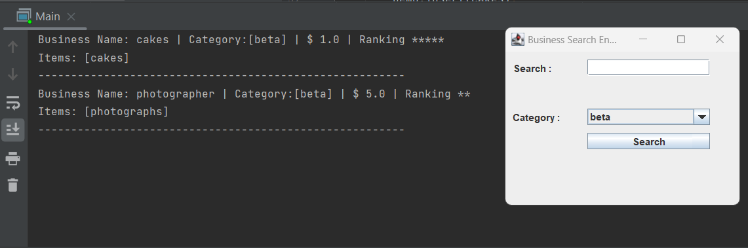
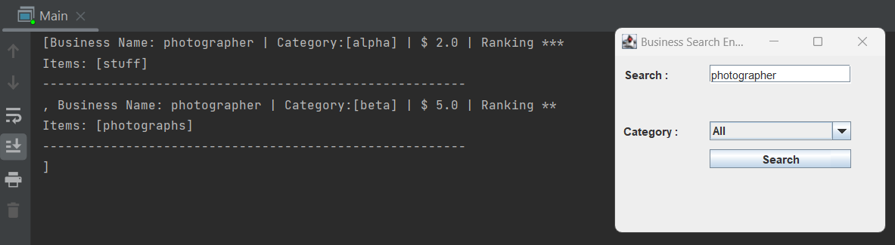
Project showcase

Slide 10

References
To develop this project, the group members have taken inspiration from the following sources:
https://www.w3schools.com/java/default.asp (Basic Java glossary)
https://www3.ntu.edu.sg/home/ehchua/programming/java/j4a_gui.html (Java GUI Design)

Slide 11
THANK YOU

